Slide 1

CLOUD coMPUTING
k.Abinaya
III bsc cs Shift1
Guide:
Dr . Kokila

Slide 2

ABSTRACT
This cloud computing application is used in different scenario, we can use anywhere like common, college or office anywhere.
First user should create an account, once user has created an account, they have a unique username and password.
using this credential to login this application. Once login has completed, Category wise we can divide and make some differentiate compare to another folders, then click on the folder then it will move to files uploading option and downloading options.

Slide 3

OBJECTIVE
Main objective of this application is an uploading and downloading some files into the server and we can download it from another server the main advantages is very secure.

Slide 4
HARDWARE SPECFICATION
Processor : P 4 700 GHz.
RAM : 4 GB RAM
Hard Disk Drive : 180 GB

Slide 5
SOFTWARE SPECIFICATION
Operating System : Windows 10
Front End : PYTHON
Back End : SQL

Slide 6
EXISTING SYSTEM
we can manage files and photos are in only laptop and mobile phone only. When the laptop or mobile can’t working or issue will be happening, we may chance to miss our photos and files. If the files are most important, we have to suffering the issue.
Disadvantages
Facing unwanted issue
May chance to miss photos and files

Slide 7
PROPOSED SYSTEM
In this system can managing the file and photos very secure. Even the user missing the file it has to be saved in the cloud. So, after the user deleting the file these files are saved in a cloud so we can retrieve.
Advantages
Safe and secure
Uploading and retrieving a file
Can access any where

Slide 8
MODULE
User registration
User login
File uploading
Uploading file maintenance
encryption and decryption

Slide 9
User registration
This user registration module is a first screen of our application, the user should register the application form and register the user details. We can collect and getting the information from the system like mobile number, username and password etc.…

Slide 10
User login
After create the user registration every user having username and password, using this username and password the user enters into the login. For secure purpose user should login this system otherwise unknown user also login into this software.

Slide 11
file uploading
This module is main concept of this project, which user can upload any type of document like ppt,pdf,docx etc…. any time of document can upload by the user. Once the user uploads the document which will upload into the cloud.

Slide 12
Uploading file maintenance
Upload files are maintained by the cloud, the cloud will maintain the files very secure and safe. If the user missing some files in our own system or mobile we can get it from this computing system

Slide 13
Encryption and decryption
This encryption and decryption module is used when the user uploading a file. Which is common way of secure to uploading file into the cloud. That’s why which system is very safe and secure.

Slide 14

Data Flow Diagram
Level 0

Slide 15
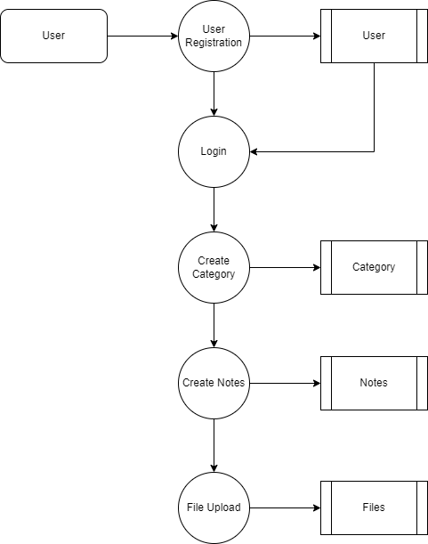
Level 1:

Slide 16
TABLE name: user
TABLE STRUCTURE
FIELD | DATA TYPE | SIZE | CONSTRAINT
User id | Int | 10 | Primary key
Name | Varchar | 30 | Not null
Email | Varchar | 30 | Not null
Phone | Varchar | 10 | Not null
Institution | Varchar | 20 | Not null
Location | Varchar | 20 | Not null
Password | Varchar | 30 | Not null

Slide 17
TABLE NAME:Category
FIELD | DATA TYPE | SIZE | CONSTRAINT
Category id | Int | 10 | Primary key
Name | Varchar | 20 | Not null
Institution | Varchar | 20 | Not null
Description | Varchar | 30 | Not null

Slide 18
TABLE NAME: Notes
FIELD | DATA TYPE | SIZE | CONSTRAINT
Note id | Int | 10 | Primary key
Title | Varchar | 30 | Foreign key
Description | Varchar | 30 | Not null

Slide 19
TABLE NAME:Topic
FIELD | DATA TYPE | SIZE | CONSTRAINT
Topic id | Int | 10 | Primary key
Topic Name | Varchar | 20 | Not null
User Id | int | 10 | Foreign Key

Slide 20
TABLE NAME:File
FIELD | DATA TYPE | SIZE | CONSTRAINT
File id | Int | 10 | Primary key
Image Id | Int | 20 | Not null
File Link | Varchar | 30 | Not null
Download Id | Int | 10 | Not null

Slide 21
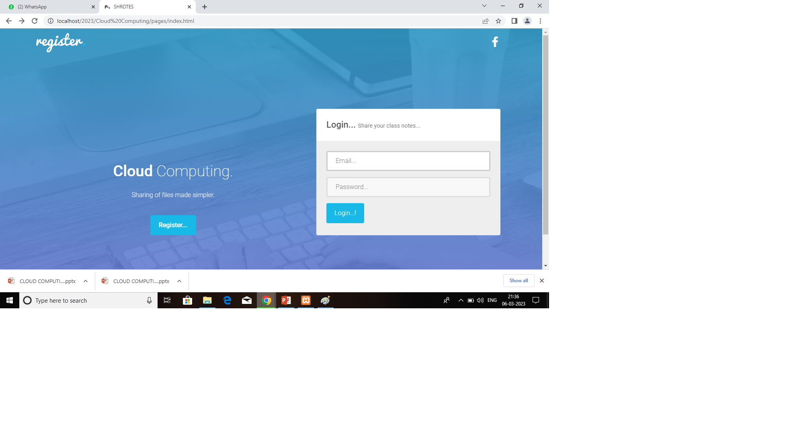
Form design

Slide 22
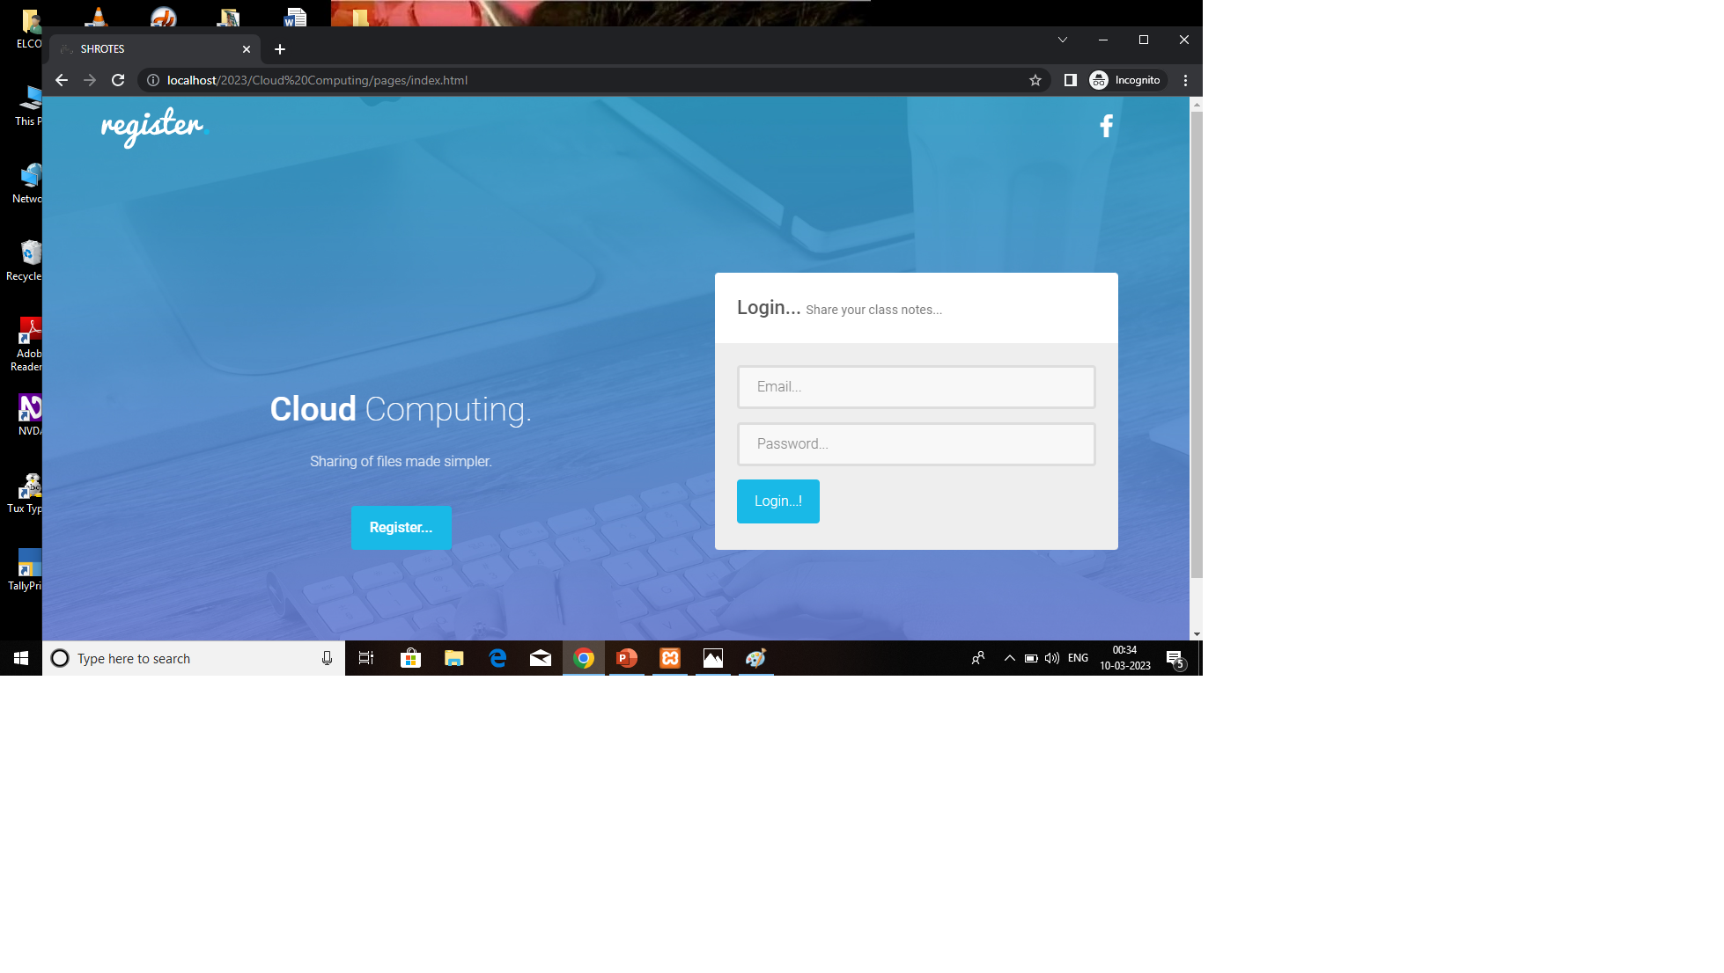
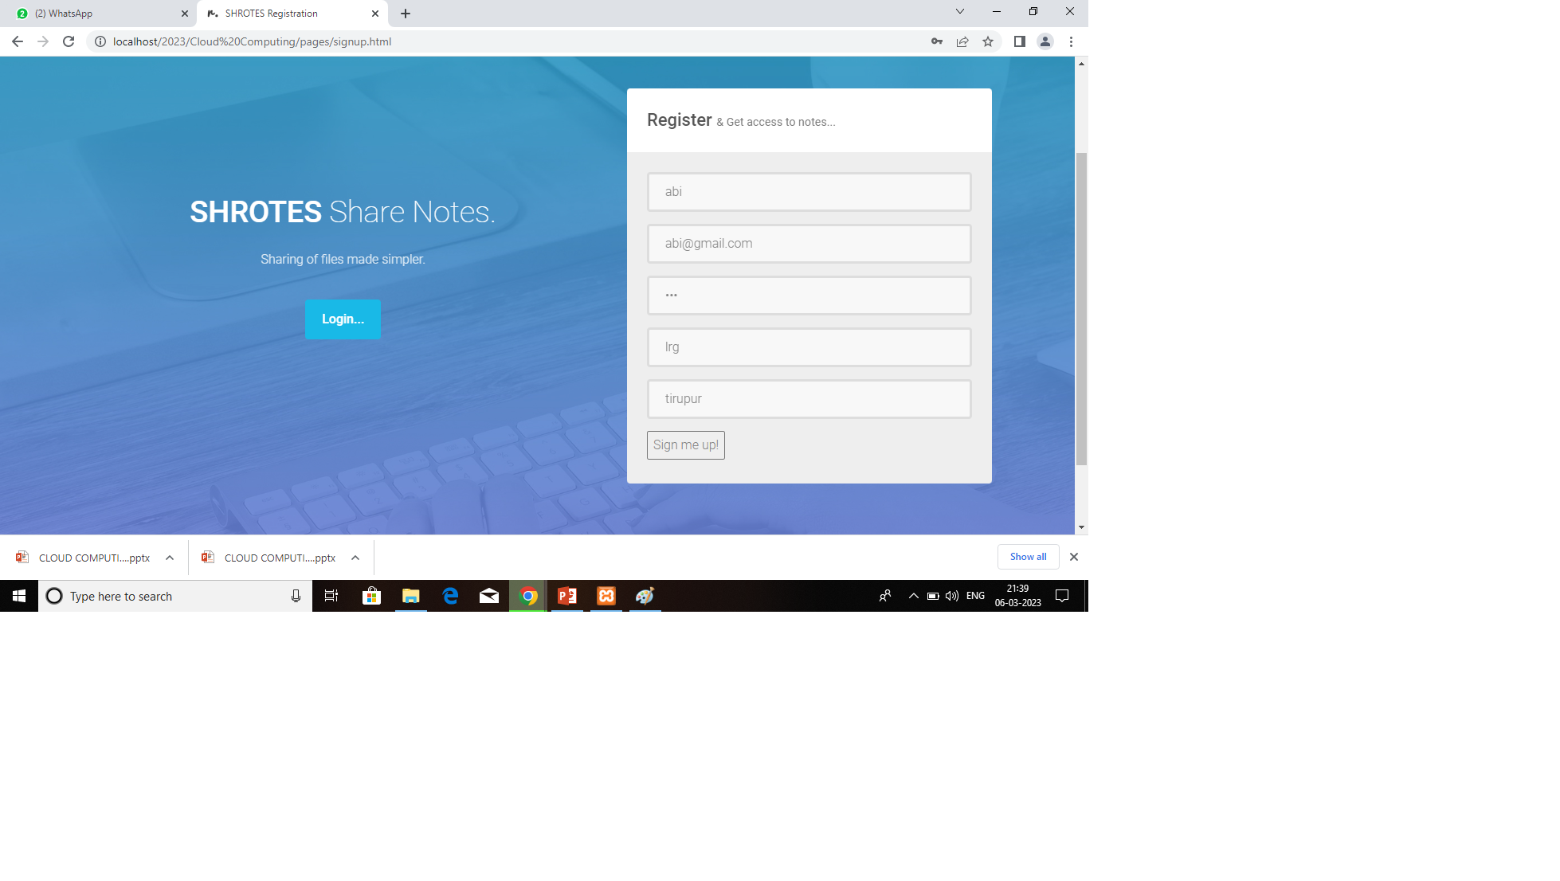
User registration

Slide 23
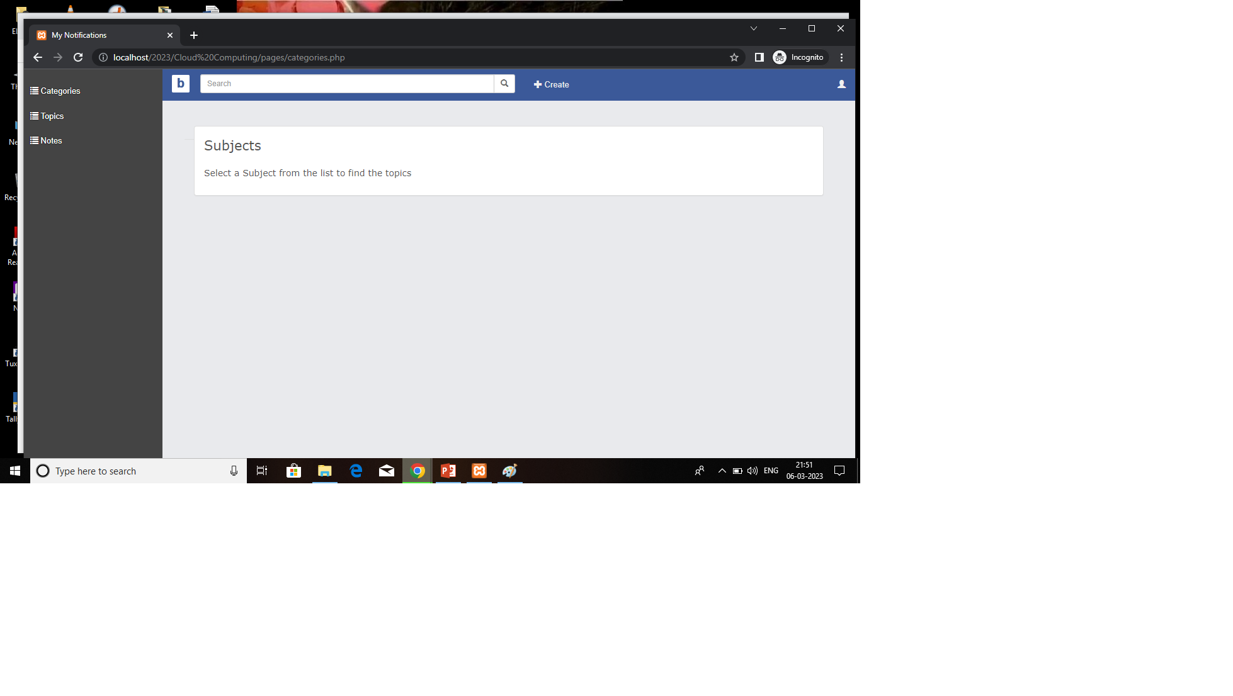
subject

Slide 24
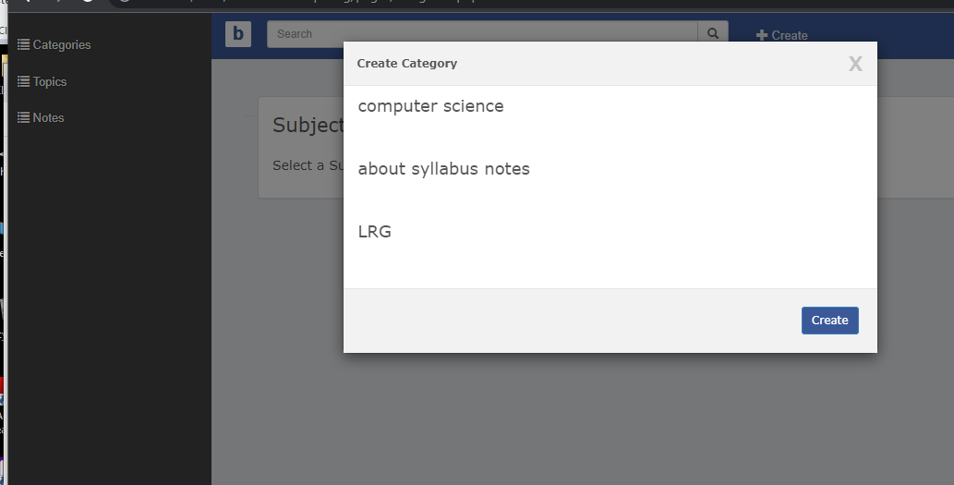
category

Slide 25
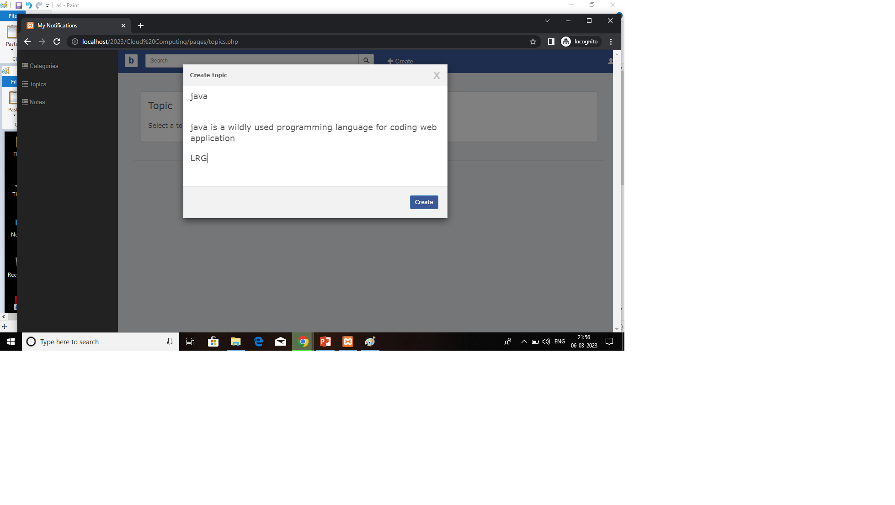
topic

Slide 26
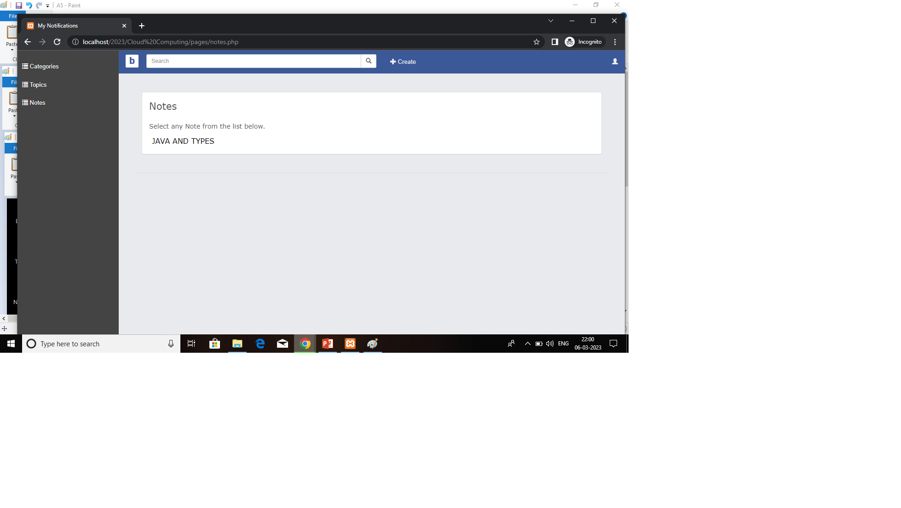
notes

Slide 27
Thank You

